Slide 1


CS101: Introduction to Computing Lecture 3: Programming Introduction
Dr. Mohammad Nauman
Assistant Professor (CS), National University of Computer and Emerging Sciences
mohammad.nauman@nu.edu.pk
http://recluze.wordpress.com

Slide 2
Recall from last time
Computer science is about problem solving
To solve problems, we first need to be able to formalize it
Notes:
Problem solving technique is important syntax is not important for CS student

Slide 3
Types of knowledge
Declarative
Imperative

Slide 4
Case study: square roots
How do you calculate the square root?

Slide 6
How to talk to computers
Programming languages (recipes)
Interpreter
Flow of control (working)
Instructions (steps) modify data (ingredients) in locations (utensils)
Notes:
Since we are using a language that the computer doesn’t understand, we need an interpreter
Whenever there is communication, there has to be a flow … to make sense

Slide 7
Machine language
Memory, registers, instructions, parameters
1 …
2 mov ax, 4
…
15 jmp 2

Slide 8
Meaning in a language
Syntax
Static Semantics
Semantics
Notes:
Syntax error: 3.2 3.2
Static semantics error: 1.0 + “meow”
There are no semantics “errors” .. Only unintentional semantics

Slide 9
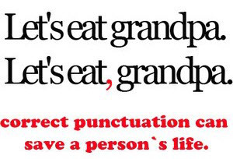
Semantic errors
Crash
Run to infinity
Run and produce an output (without assurance of correctness)
Notes:
In order to be able to handle all these errors, we need to understand computer languages in detail

Slide 10
Categorizations of languages
Low-level versus high level
General versus domain specific
Interpreted versus compiled
Source code
Machine code

Slide 11
Python
High level
General purpose
Interpreted
Scripts, programs, shell

Slide 12
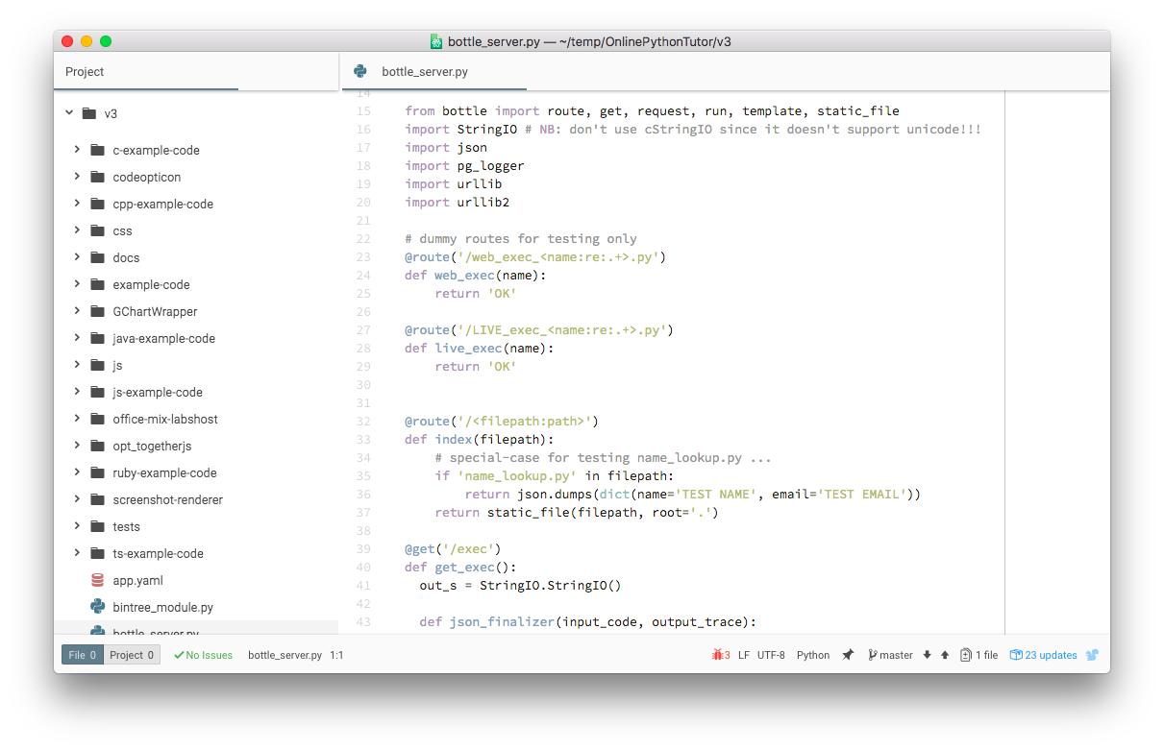
Python Script

Slide 13
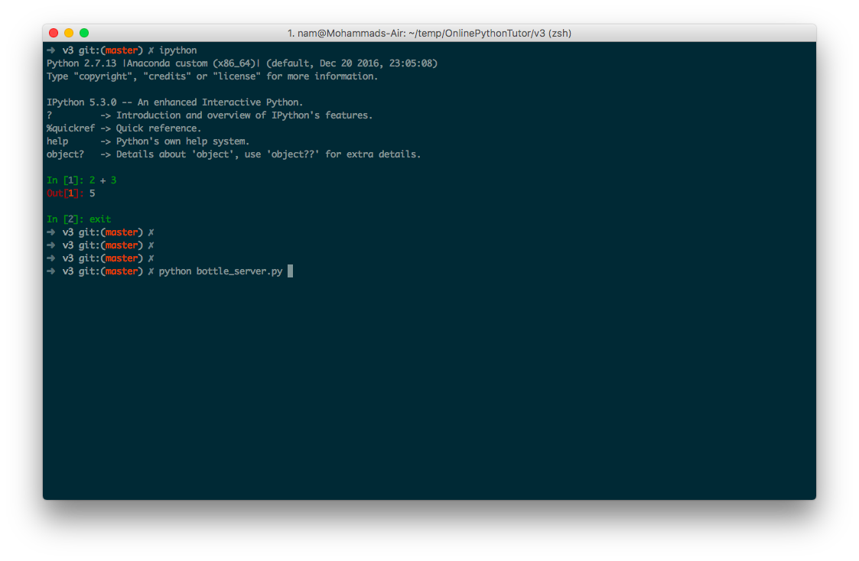
Python Shell

Slide 14
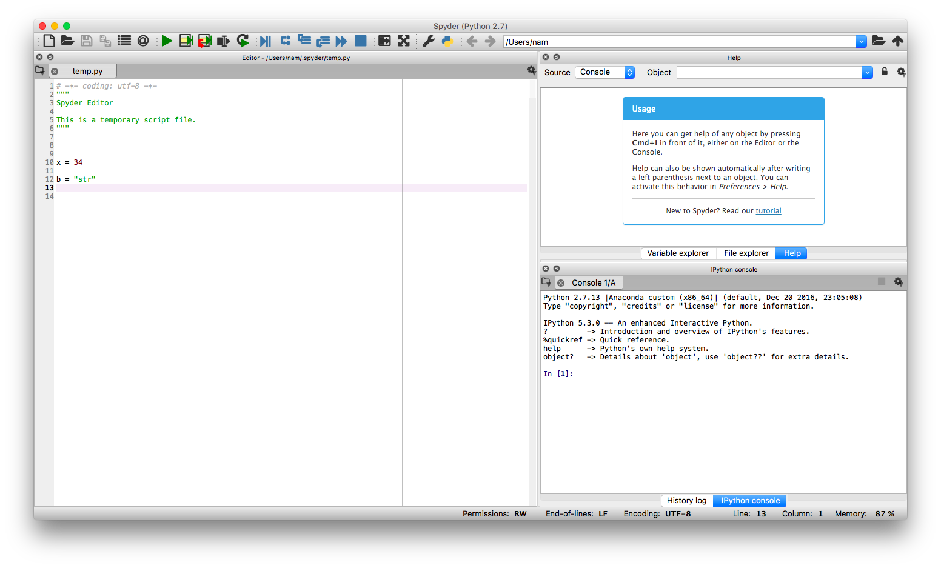
Python IDE

Slide 15
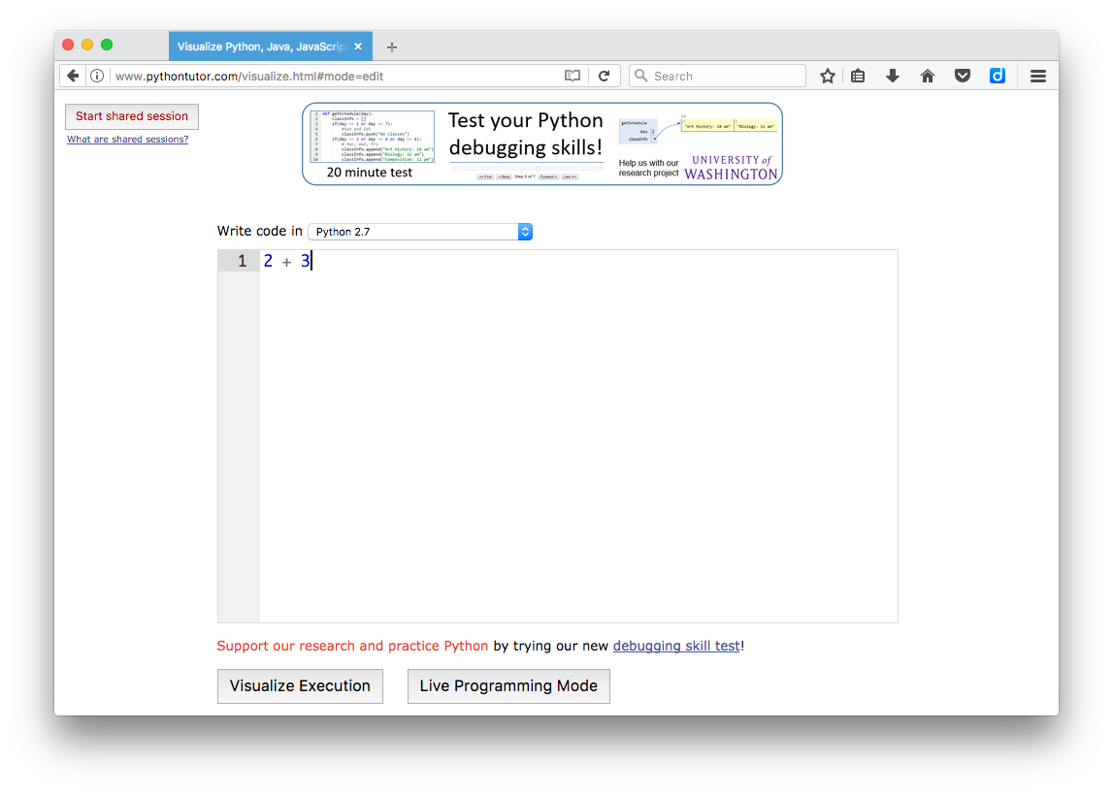
PythonTutor

Slide 16
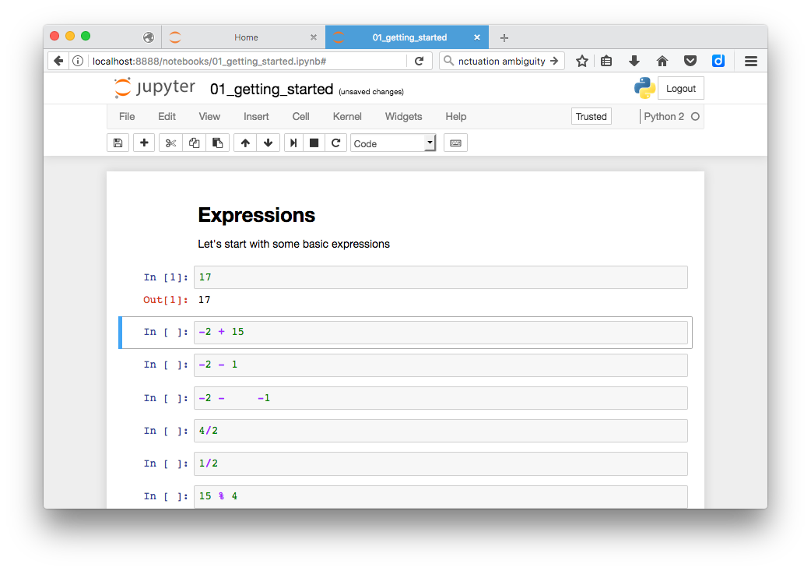
Notebook

